Slide 1



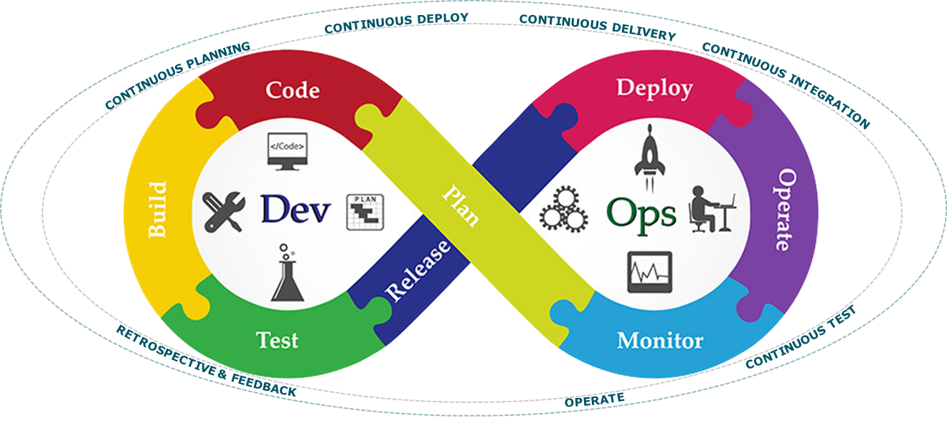
Capability
Program
Epic
Program Increment
Feature
Retrospective
Demo
Solution Backlog
Program Epic
Feature
Feature
Roles
Ceremonies
Feature
ITERATION
Program Backlog
T E S T
Plan
Story
SPIKE
Defect
Daily
Stand-Up
B U I L D
Program Increment
Release Package
Plan
Team Backlog
D E P L O Y
Backlog Elaboration
Demo
&
Retro
Mid Iteration Checkpoint
P R E P
D E S I G N
SoS
Execute
PO Sync

Slide 2
Plan
Plan
Epic
Epic
Epic
portfolio Backlog
Plan
Plan
Capability
Program
Epic
Feature
Solution Backlog
Plan
Plan
Program Epic
Feature
Feature
Feature
Program Backlog
Plan
Story
SPIKE
Defect
Plan
Team Backlog

Slide 3
Strategy & Investment
Portfolio
Measure & Grow
Epic
Epic
Lean Portfolio
Governance
Epic
Program(s)/Solution(s)
Portfolio Backlog
Plan
Solution Intent
Capability
Program
Epic
Lean Solution
& Partner
Governance
Feature
Project(s)/Product(s)
Solution Backlog
Requirements
Lean Program
& Product
Governance
Plan
Plan
Program Epic
Feature
Feature
Feature
Program Backlog
Continuous Delivery
Continuous Integration
Team(s)
Continuous Deploy
Plan
Story
SPIKE
Defect
Roles
Ceremonies
Continuous Planning
Team Backlog
Continuous Operations
Continuous Exploration
Continuous Feedback

Slide 4
Strategy & Investment
Portfolio
Measure & Grow
Epic
Epic
Lean Portfolio
Governance
Epic
Program(s)/Solution(s)
Portfolio Backlog
Plan
Solution Intent
Adaptability
Capability
Program
Epic
Lean Solution
& Partner
Governance
Customer
Centricity
Feature
Project(s)/Product(s)
Solution Backlog
Requirements
Lean Program
& Product
Governance
Plan
Plan
Program Epic
Feature
Feature
Feature
Collaboration
Program Backlog
Continuous Delivery
Culture
Continuous Integration
Team(s)
Continuous Deploy
Plan
Story
SPIKE
Defect
Roles
Ceremonies
Continuous Planning
Personal
Development
Team Backlog
Business & Team
Agility
Continuous
Learning
Continuous Operations
Continuous Exploration
Lean
DevOps
Canvas
Agile
Use Case Mapping
Communication
Continuous Feedback
Systems Thinking
Standards
Retrospect
Adapt
and
Learn
Design Thinking
Customer Journeys
Product, Project
& Program

Slide 5
Strategy & Investment
Portfolio
Measure & Grow
Epic
Epic
Lean Portfolio
Governance
Epic
Program(s)/Solution(s)
Portfolio Backlog
Understanding
Solution Intent
Succuss
Factors
Plan
Program
Epic
Customer
Centricity
Adaptability
Capability
Lean Solution
& Partner
Governance
Expectations
Feature
Project(s)/Product(s)
Solution Backlog
Experiences
Requirements
Lean Program
& Product
Governance
Plan
Plan
Respect
Program Epic
Principles
&
Practices
Feature
Feature
Feature
Program Backlog
Continuous Delivery
Relentless
Improvement
Culture
Continuous Integration
Team(s)
Continuous Deploy
Plan
Growth
Story
SPIKE
Defect
Roles
Ceremonies
Continuous Planning
Team Backlog
Increment of Working Outcomes
Team/Product/Solution
Personal
Business
& Team
Agility
Continuous
Learning
Team
Continuous Operations
Organisational
DevOps
Continuous Exploration
Lean
Agile
Canvas
Built in
Quality
Continuous Feedback
Use Case Mapping
Standards
Retrospect
Adapt
and
Learn
Systems Thinking
Design Thinking
Customer Journeys
Product, Project
& Program

Slide 6
Vision
Strategy & Investment
Portfolio
Measure & Grow
Epic
Epic
Portfolio Roles
Contracts
Portfolio
Ceremonies
Epic
Lean Portfolio
Governance
Portfolio Backlog
Program(s)/Solution(s)
Understanding
Milestones
O
K
R’s
Succuss
Factors
Plan
Solution Intent
Solution Roles
Solution
Ceremonies
Tooling
Capability
Program
Epic
Lean Solution
& Partner
Governance
Expectations
Customer
Centricity
Feature
Project(s)/Product(s)
Solution Backlog
K
P
I’s
Experiences
Requirements
Roadmap
Plan
Product Roles
Product
Ceremonies
Lean Program
& Product
Governance
Respect
Plan
Program Epic
Principles
&
Practices
Feature
Feature
Feature
M
e
t
r
i
c
s
Program Backlog
Team(s)
Relentless
Improvement
Culture
Continuous Integration
Continuous Delivery
Continuous Deploy
Commitment
Plan
Growth
Story
SPIKE
Defect
Team Roles
Team
Ceremonies
Continuous Planning
Team Backlog
Demo
& Retro
Increment of Working Outcomes
Team/Product/Solution
Personal
Business
& Team
Agility
<Image of team standing around board>
Continuous
Learning
Team
Continuous Operations
Organisational
DevOps
Continuous Exploration
Lean
Agile
Canvas
Built in
Quality
Continuous Feedback
Use Case Mapping
Standards
Demonstrate
Retrospect
Adapt
Learn
Systems Thinking
Design Thinking
Customer Journeys
Product, Project
& Program
Telemetry
Lean – Agile Mindset
Leadership & Climate for Sustainable Change
Learning Communities

Slide 7

Vision
Strategy & Investment
Portfolio
Measure & Grow
Epic
Portfolio Roles
Contract
Portfolio
Ceremonies
Lean Portfolio
Governance
Epic
Value Stream
Epic
Program(s)/Solution(s)
Understanding
Portfolio Backlog
O
K
R’s
Automation
Milestone
Succuss Factors
Solution Intent
Guardrails
Plan
Solution
Epic
Solution Roles
Solution
Ceremonies
Customer
Centricity
Tooling
Work
Management
Capability
Lean Solution
& Partner
Governance
Expectations
Feature
Project(s)/Product(s)
Telemetry
Solution Backlog
K
P
I’s
Requirements
Roadmap
Experiences
DevXOps
Is my Job
Plan
Plan
Product Roles
Product
Ceremonies
Lean Program
& Product
Governance
Respect
Product Epic
Feature
Feature
Principles
&
Practices
Feature
M
e
t
r
i
c
s
Infrastructure
as Code
Product Backlog
Continuous Delivery
Relentless
Improvement
Culture
Continuous Integration
Team(s)
Kata
Commitment
Continuous Deploy
Plan
Growth
Story
SPIKE
Defect
Team Roles
Team
Ceremonies
Continuous Planning
Team Backlog
Demo
& Retro
Increment of Working Outcomes
Team/Product/Solution
Personal
Team
Agility
Business
<Image of team standing around board>
Team
Continuous
Learning
Technical
Continuous Operations
Deliver | Deliver | Deliver | Deliver | Deliver | Inspect & Adapt
Organisational
DevOps
Continuous
Test
DevXOps
Lean
Agile
Continuous Exploration
Canvas
Built in
Quality
Use Case Mapping
Shift Left
Continuous Feedback
Systems Thinking
Standards
Demonstrate
Retrospect
Adapt
Learn
Design Thinking
Customer Journeys
Product, Project
& Program
Telemetry
Lean – Agile Mindset
Leadership & Climate for Sustainable Change
Learning Communities

Slide 8
Vision
Strategy & Investment
Portfolio
Measure & Grow
Epic
Portfolio Roles
Contract
Portfolio
Ceremonies
Lean Portfolio
Governance
Epic
Value Stream
Epic
Program(s)/Solution(s)
Understanding
Portfolio Backlog
O
K
R’s
Automation
Milestone
Succuss Factors
Solution Intent
Guardrails
Plan
Program
Epic
Solution Roles
Solution
Ceremonies
Customer
Centricity
Tooling
Work
Management
Capability
Lean Solution
& Partner
Governance
Expectations
Feature
Project(s)/Product(s)
Telemetry
Solution Backlog
K
P
I’s
Requirements
Roadmap
Experiences
DevXOps
Is my Job
Plan
Plan
Product Roles
Product
Ceremonies
Lean Program
& Product
Governance
Respect
Product Epic
Feature
Feature
Principles
&
Practices
Feature
M
e
t
r
i
c
s
Infrastructure
as Code
Product Backlog
Continuous Delivery
Relentless
Improvement
Culture
Continuous Integration
Team(s)
Kata
Commitment
Continuous Deploy
Plan
Growth
Story
SPIKE
Defect
Team Roles
Team
Ceremonies
Organisational
Continuous Planning
Team Backlog
Demo
& Retro
Increment of Working Outcomes
Team/Product/Solution
Personal
Business
Agility
Technical
<Image of team standing around board>
Team
OILS
Team
Continuous Operations
Deliver | Deliver | Deliver | Deliver | Deliver | Inspect & Adapt
Organisational
DevOps
Continuous
Test
DevXOps
Lean
Agile
Continuous Exploration
Canvas
Built in
Quality
Use Case Mapping
Shift Left
Continuous Feedback
Systems Thinking
Standards
Demonstrate
Retrospect
Adapt
Learn
Design Thinking
Customer Journeys
Product, Project
& Program
Telemetry
Lean – Agile Mindset
Leadership & Climate for Sustainable Change
Learning Communities

Slide 9
Portfolio
Portfolio Roles
Portfolio
Ceremonies
Program(s)/Solution(s)
Understanding
Succuss Factors
Solution Roles
Solution
Ceremonies
Customer
Centricity
Tooling
Expectations
Project(s)/Product(s)
Experiences
Product Roles
Product
Ceremonies
Respect
Principles
&
Practices
Team(s)
Relentless
Improvement
Culture
Growth
Team Roles
Team
Ceremonies
Increment of Working Outcomes
Team/Product/Solution
Demo
& Retro
Personal
Agility
Business
<Image of team standing around board>
Team
OILS
Technical
Continuous Operations
Deliver | Deliver | Deliver | Deliver | Deliver | Inspect & Adapt
Organisational
DevOps
Continuous
Test
Lean
Agile
Continuous Exploration
Canvas
Built in
Quality
Use Case Mapping
Shift Left
Continuous Feedback
Systems Thinking
Standards
Demonstrate
Retrospect
Adapt
Learn
Design Thinking
Customer Journeys
Product, Project
& Program
Telemetry
Lean – Agile Mindset
Leadership & Climate for Sustainable Change
Learning Communities

Slide 10
Vision
Strategy & Investment
Epic
Epic
Epic
Portfolio Backlog
Plan
Solution Intent
Capability
Solution
Epic
Feature
Solution Backlog
Requirements
Plan
Product Epic
Feature
Feature
Feature
Product Backlog
Continuous Delivery
Continuous Integration
Continuous Deploy
Plan
SPIKE
Plan
Story
Defect
Team Roles
Team
Ceremonies
Continuous Planning
Team Backlog
Demo
& Retro
Increment of Working Outcomes
Team/Product/Solution
<Image of team standing around board>
Continuous Operations
Deliver | Deliver | Deliver | Deliver | Deliver | Inspect & Adapt
Continuous Exploration
DevXOps
Continuous Feedback
Demonstrate
Retrospect
Adapt
Learn

Slide 11
Vision
Strategy & Investment
Epic
Epic
Epic
Portfolio Epic
Portfolio Backlog
Plan
Solution
Epic
Solution Intent
Capability
Solution Epic
Feature
Solution Backlog
Solution Capability
Plan
Requirements
Product Epic
Product Epic
Feature
Feature
Feature
Product Backlog
Feature
Plan
SPIKE
Plan
Story
Defect
Story
Team Backlog

Slide 12
Requirements
Product Epic
Feature
Feature
Feature
Product Backlog
Continuous Delivery
Continuous Integration
Continuous Deploy
Plan
SPIKE
Plan
Story
Defect
Team Roles
Team
Ceremonies
Continuous Planning
Team Backlog
Demo
& Retro
Increment of Working Outcomes
Team/Product/Solution
<Image of team standing around board>
Continuous Operations
Deliver | Deliver | Deliver | Deliver | Deliver | Inspect & Adapt
Continuous Exploration
DevXOps
Continuous Feedback
Demonstrate
Retrospect
Adapt
Learn

Slide 13
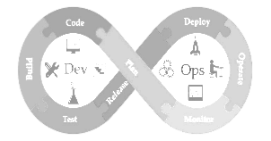
Continuous Delivery
Continuous Integration
Continuous Deploy
SPIKE
Plan
Story
Defect
Team Roles
Team
Ceremonies
Continuous Planning
Team Backlog
Demo
& Retro
Increment of Working Outcomes
Team/Product/Solution
<Image of team standing around board>
Continuous Operations
Deliver | Deliver | Deliver | Deliver | Deliver | Inspect & Adapt
X
Continuous Exploration
Dev
Ops
Continuous Feedback
Demonstrate
Retrospect
Adapt
Learn

Slide 14
Plan
Product Epic
Feature
Feature
Feature
Product Backlog
SPIKE
Plan
Plan
Story
Defect
Team Backlog
Stand-up
Demo
& Retro
Plan
Guiding
Team
Deliver | Deliver | Deliver | Deliver | Deliver | Inspect & Adapt
X
Dev
Ops
Program Increment (PI)
Three roles
Executive Sponsor
Guiding Team
Change Agents (as needed)
Four meetings
PI Planning
Stand-up (1-2/wk)
PI Demo
PI Retrospective

Slide 15
ART = VDU – Value Delivery Unit or VDC – Value Delivery Construct
ST = SDU – Solution Delivery Unit or SDC – Solution Delivery Construct
Plan
Product Epic
Feature
Feature
Feature
Product Backlog
SPIKE
Plan
Plan
Story
Defect
Team Backlog
Stand-up
Demo
& Retro
Increment of Working Outcomes
Team/Product/Solution
Plan
Agile
Team
Deliver | Deliver | Deliver | Deliver | Deliver | Inspect & Adapt
X
Dev
Ops
Program Increment (PI)
The Roles
Scrum Master (SM)
Product Owner (PO)
Delivery Team
Primary Ceremonies
Sprint Planning
Daily Stand Up (DSU)
Sprint Checkpoint
Backlog Refinement Session
Sprint Demo
Sprint Retrospective
The
Agile
Team

Slide 16
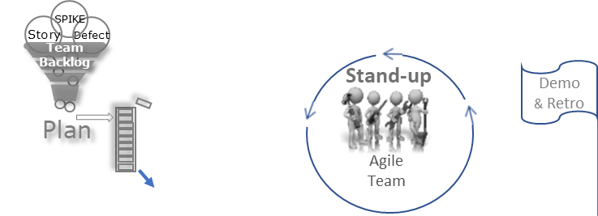
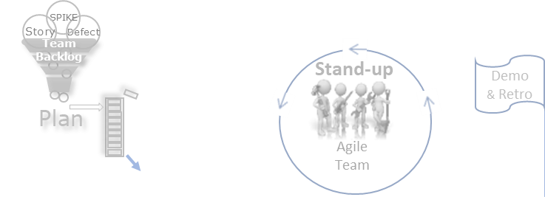
ART = VDU – Value Delivery Unit or VDC – Value Delivery Construct
ST = SDU – Solution Delivery Unit or SDC – Solution Delivery Construct
Plan
Product Epic
Feature
Feature
Feature
Product Backlog
SPIKE
Plan
Plan
Story
Defect
Team Backlog
Stand-up
Demo
& Retro
Increment of Working Outcomes
Team/Product/Solution
Plan
Agile
Team
Deliver | Deliver | Deliver | Deliver | Deliver | Inspect & Adapt
X
Dev
Ops
Program Increment (PI)
The Roles/Groups
Delivery Unit (DU) Lead
System Architect
System Owner
Primary ceremonies
Delivery Increment (aka Big Room) Planning
Scrum of Scrums (SoS)
Product Owner (PO) Sync
Delivery Increment (DI) Demo
Delivery Increment (DI) Retrospective

Slide 17
ART = VDU – Value Delivery Unit or VDC – Value Delivery Construct
ST = SDU – Solution Delivery Unit or SDC – Solution Delivery Construct
Capability
Solution
Epic
Feature
Solution Backlog
Solution PI
Plan
Plan
Product Epic
Feature
Feature
Feature
Product Backlog
Plan
SPIKE
Story
Defect
Team Backlog
Demo
& Retro
Increment of Working Outcomes
Team/Product/Solution
Plan
Stand-up
Plan
Agile
Team
Deliver | Deliver | Deliver | Deliver | Deliver | Inspect & Adapt
X
Dev
Ops
Program Increment (PI)
The Roles/Groups
Solution Delivery Unit (SDU) Lead
Solution Architect
Solution Owner
Primary ceremonies
PI Solution Planning
Solution SoS
SO Sync
PI Solution Demo
PI Solution Retrospective

Slide 18
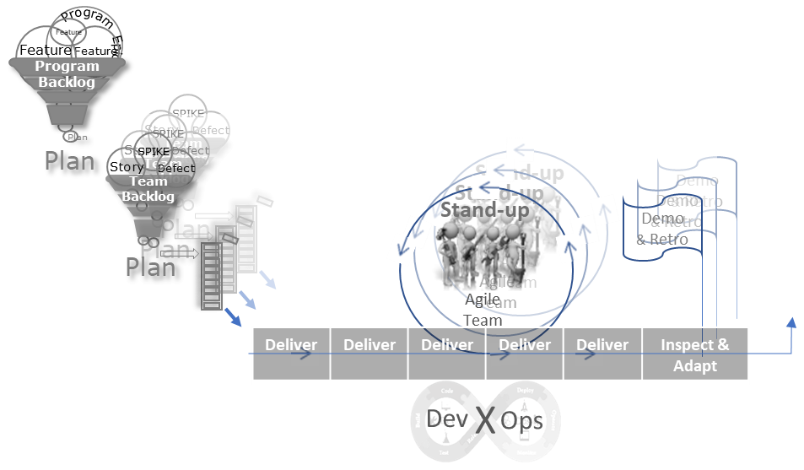

ART = VDU – Value Delivery Unit or VDC – Value Delivery Construct
ST = SDU – Solution Delivery Unit or SDC – Solution Delivery Construct
Capability
Solution
Epic
Milestone Based Partner Delivery
Feature
Milestone Based Partner Delivery
Solution Backlog
Solution PI
Plan
Plan
Increment of Working Outcomes
Team/Product/Solution
Program Increment (PI)
The Roles/Groups
Solution Delivery Unit (SDU) Lead
Solution Architect
Solution Owner
Primary ceremonies
Solution Delivery Increment (DI) Planning
Solution Scrum of Scrums (SoS)
Solution Owner (SO) Sync
Solution Delivery Increment (DI) Demo
Solution Delivery Increment (DI) Retrospective

Slide 19
ART = VDU – Value Delivery Unit or VDC – Value Delivery Construct
ST = SDU – Solution Delivery Unit or SDC – Solution Delivery Construct
Plan
Product Epic
Feature
Feature
Feature
Product Backlog
SPIKE
Plan
Plan
Story
Defect
Team Backlog
Stand-up
Demo
& Retro
Plan
Guiding
Team
Deliver | Deliver | Deliver | Deliver | Deliver | Inspect & Adapt
X
Dev
Ops
Program Increment (PI)
The Roles/Groups
VDU Lead
System Architect
Business Owner
Primary ceremonies
PI Planning
SoS
PO Sync
PI System Demo
PI Retrospective

Slide 21
Program/Product Increment
Capability
Program
Epic
Retrospective
Ceremonies
Feature
Roles
Demo
Solution Backlog
Plan
Program Epic
Feature
Feature
Feature
ITERATION
Program Backlog
T E S T
Daily
Stand-Up
B U I L D
Program Increment
Release Package
Plan
Backlog Elaboration
Demo
&
Retro
Story
SPIKE
Defect
D E P L O Y
Mid Iteration Checkpoint
Team Backlog
D E S I G N
P R E P
SoS
Execute
PO Sync

Slide 22
Program Increment
Capability
Program
Epic
Retrospective
Feature
Demo
Solution Backlog
Plan
Program Epic
Ceremonies
Feature
Feature
Feature
Roles
ITERATION
Program Backlog
T E S T
Story
SPIKE
Defect
Daily
Stand-Up
B U I L D
Program Increment
Release Package
Plan
Team Backlog
D E P L O Y
Backlog Elaboration
Demo
&
Retro
Mid Iteration Checkpoint
P R E P
D E S I G N
SoS
Execute
PO Sync

Slide 23
Plan
Epic
Epic
Epic
portfolio Backlog
Plan
Capability
Program
Epic
Feature
Solution Backlog
Plan
Program Epic
Feature
Feature
Feature
Program Backlog
Plan
Story
SPIKE
Defect
Team Backlog

Slide 24



Plan
Program Increment
Demo
Retrospective
Roles
Ceremonies
ITERATION
T E S T
Plan
Daily
Stand-Up
B U I L D
Program Increment
Release Package
Plan
D E P L O Y
Backlog Elaboration
Demo
&
Retro
Mid Iteration Checkpoint
P R E P
D E S I G N
SoS
Execute
PO Sync

Slide 25
Plan
Plan
Plan

Slide 27
Test
Define
Empathise
Prototype
Ideate

